Slide 1
Indian Sign Language Detector
USER MANUAL
Author: Aarush Chakraborty
Notes:
Preworks course home assignments

Slide 2
Table of Contents
Acknowledgements
About Me
My journey with Clevered
About my Project
How to use the Project Application

Slide 3
Acknowledgements
Starting off, I would like to express my gratitude to my mentor Mr. Avishek, and Mr. Ken for giving me an opportunity to learn so much at this internship.
The continued support & Guidance made my project possible and I’m very thankful for that!

Slide 4

About Me
I’m Aarush Chakraborty!
I’m 14 years old and and currently learning about ML, AI, and Data Science in general.

Slide 5
My Internship Journey with Clevered
Overall, I have loved my journey with Clevered so far!
I have made a very interesting project!
I have learnt many new concepts!

Slide 6
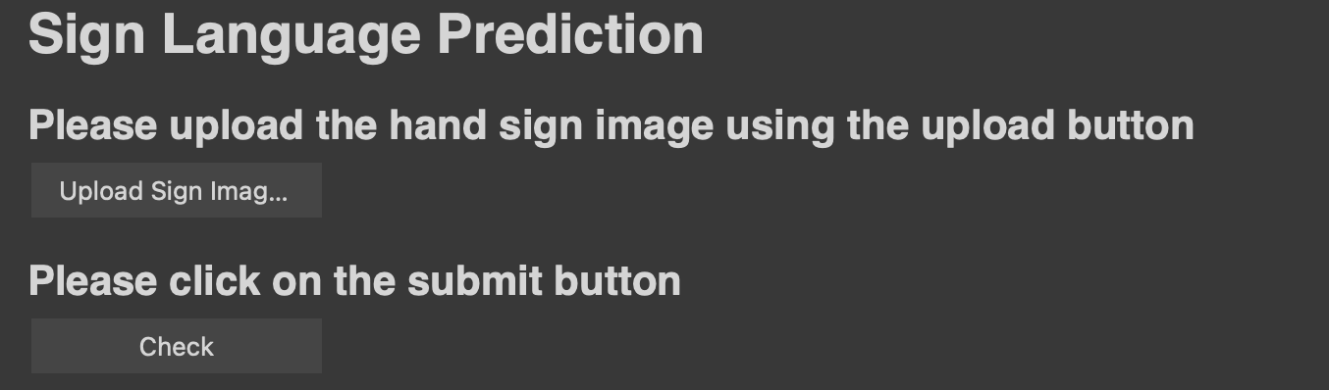
About App
My project is an Indian Sign Language Detector. It can identify and translate different hand signals.
This application can be beneficial for society as it can help many less fortunate people who have lost their hearing or cannot speak.

Slide 7
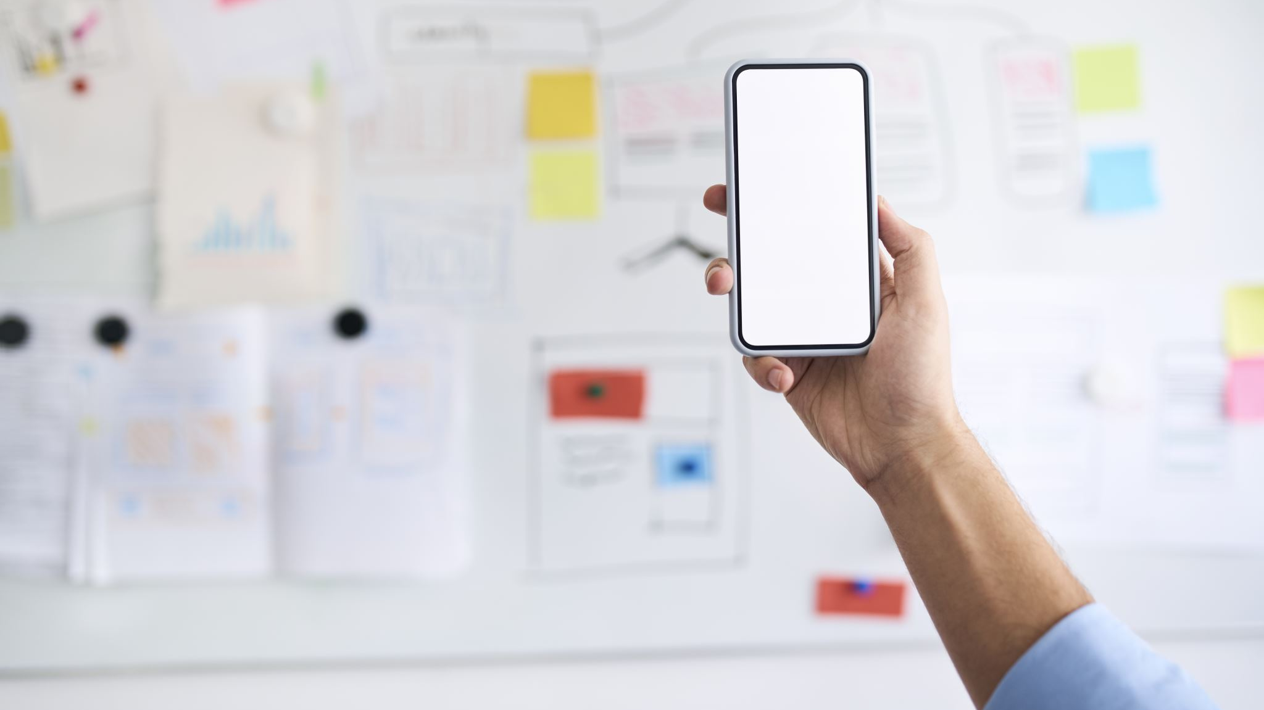
How do I use the Application?

Slide 8
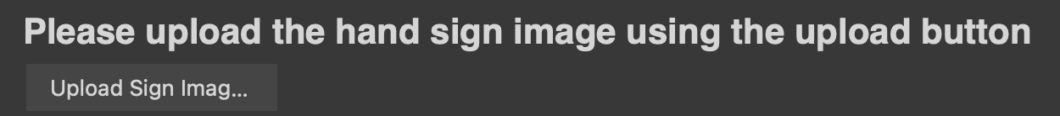
Upload Sign Image (Button)
The user will have to click on this button and upload the hand signal image from their desktop.

Slide 9
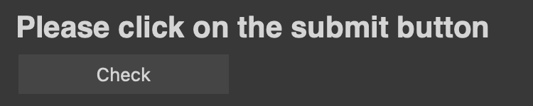
Check (Button)
After the user has uploaded their image, click this button for the program to start and analyze the image.
This button won’t work unless you’ve uploaded your image.

Slide 10
Demo

Slide 11
Contact Person
In case of any issues, please reach out to me at:
arpitamukhjee@gmail.com
Or Chakraborty.Aarush@gmail.com

Slide 12
Thank You!

